Slide 1
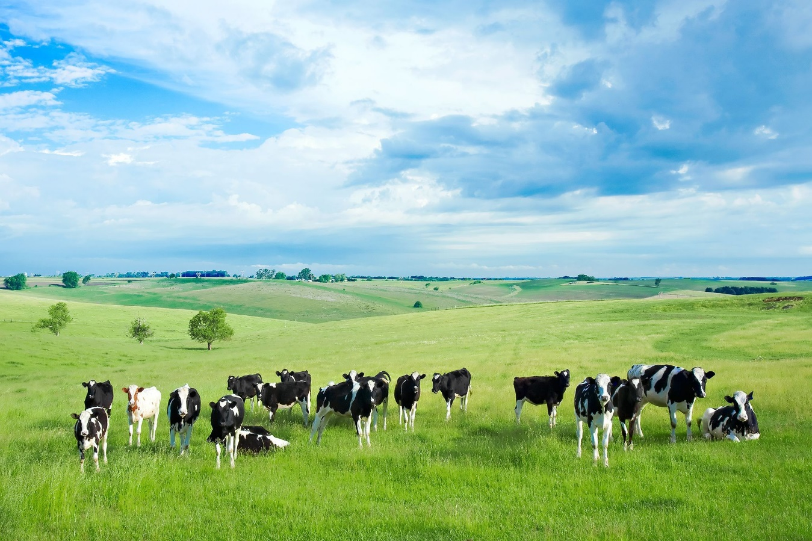
Project: Farm Together
SUBMITTED BY ,
Ahasanul Bari Rifat
UG02-47-18-0007
DEPARTMENT OF CSE
SUBMITTED TO
KHAN MD HASIB
LECTURE DEOARTMENT OF CSE

Slide 2
Motivational Discussion:
1. The real world problem
and problem solving
2. And it’s importance

Slide 3
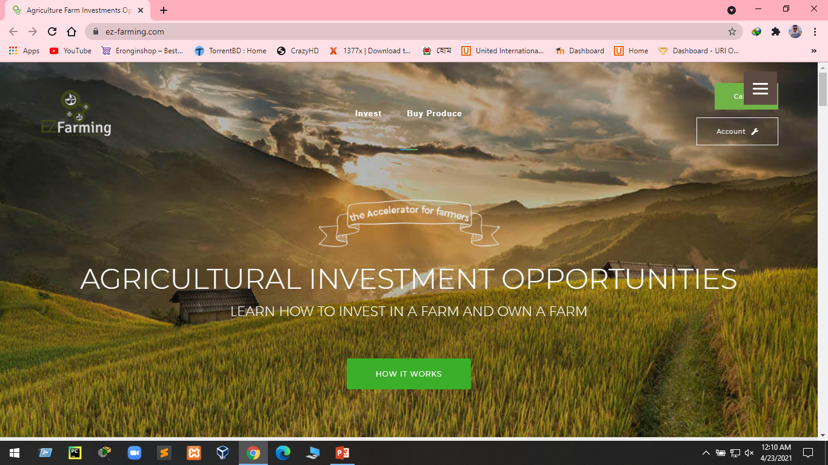
Existing Scenario
https://ez-farming.com/
Major Features:
Invest
Buy Produce

Slide 4

Main Features
Investing

Slide 5


Others Features
Communications Between Farmer And Investor:
Daily Status:

Slide 6
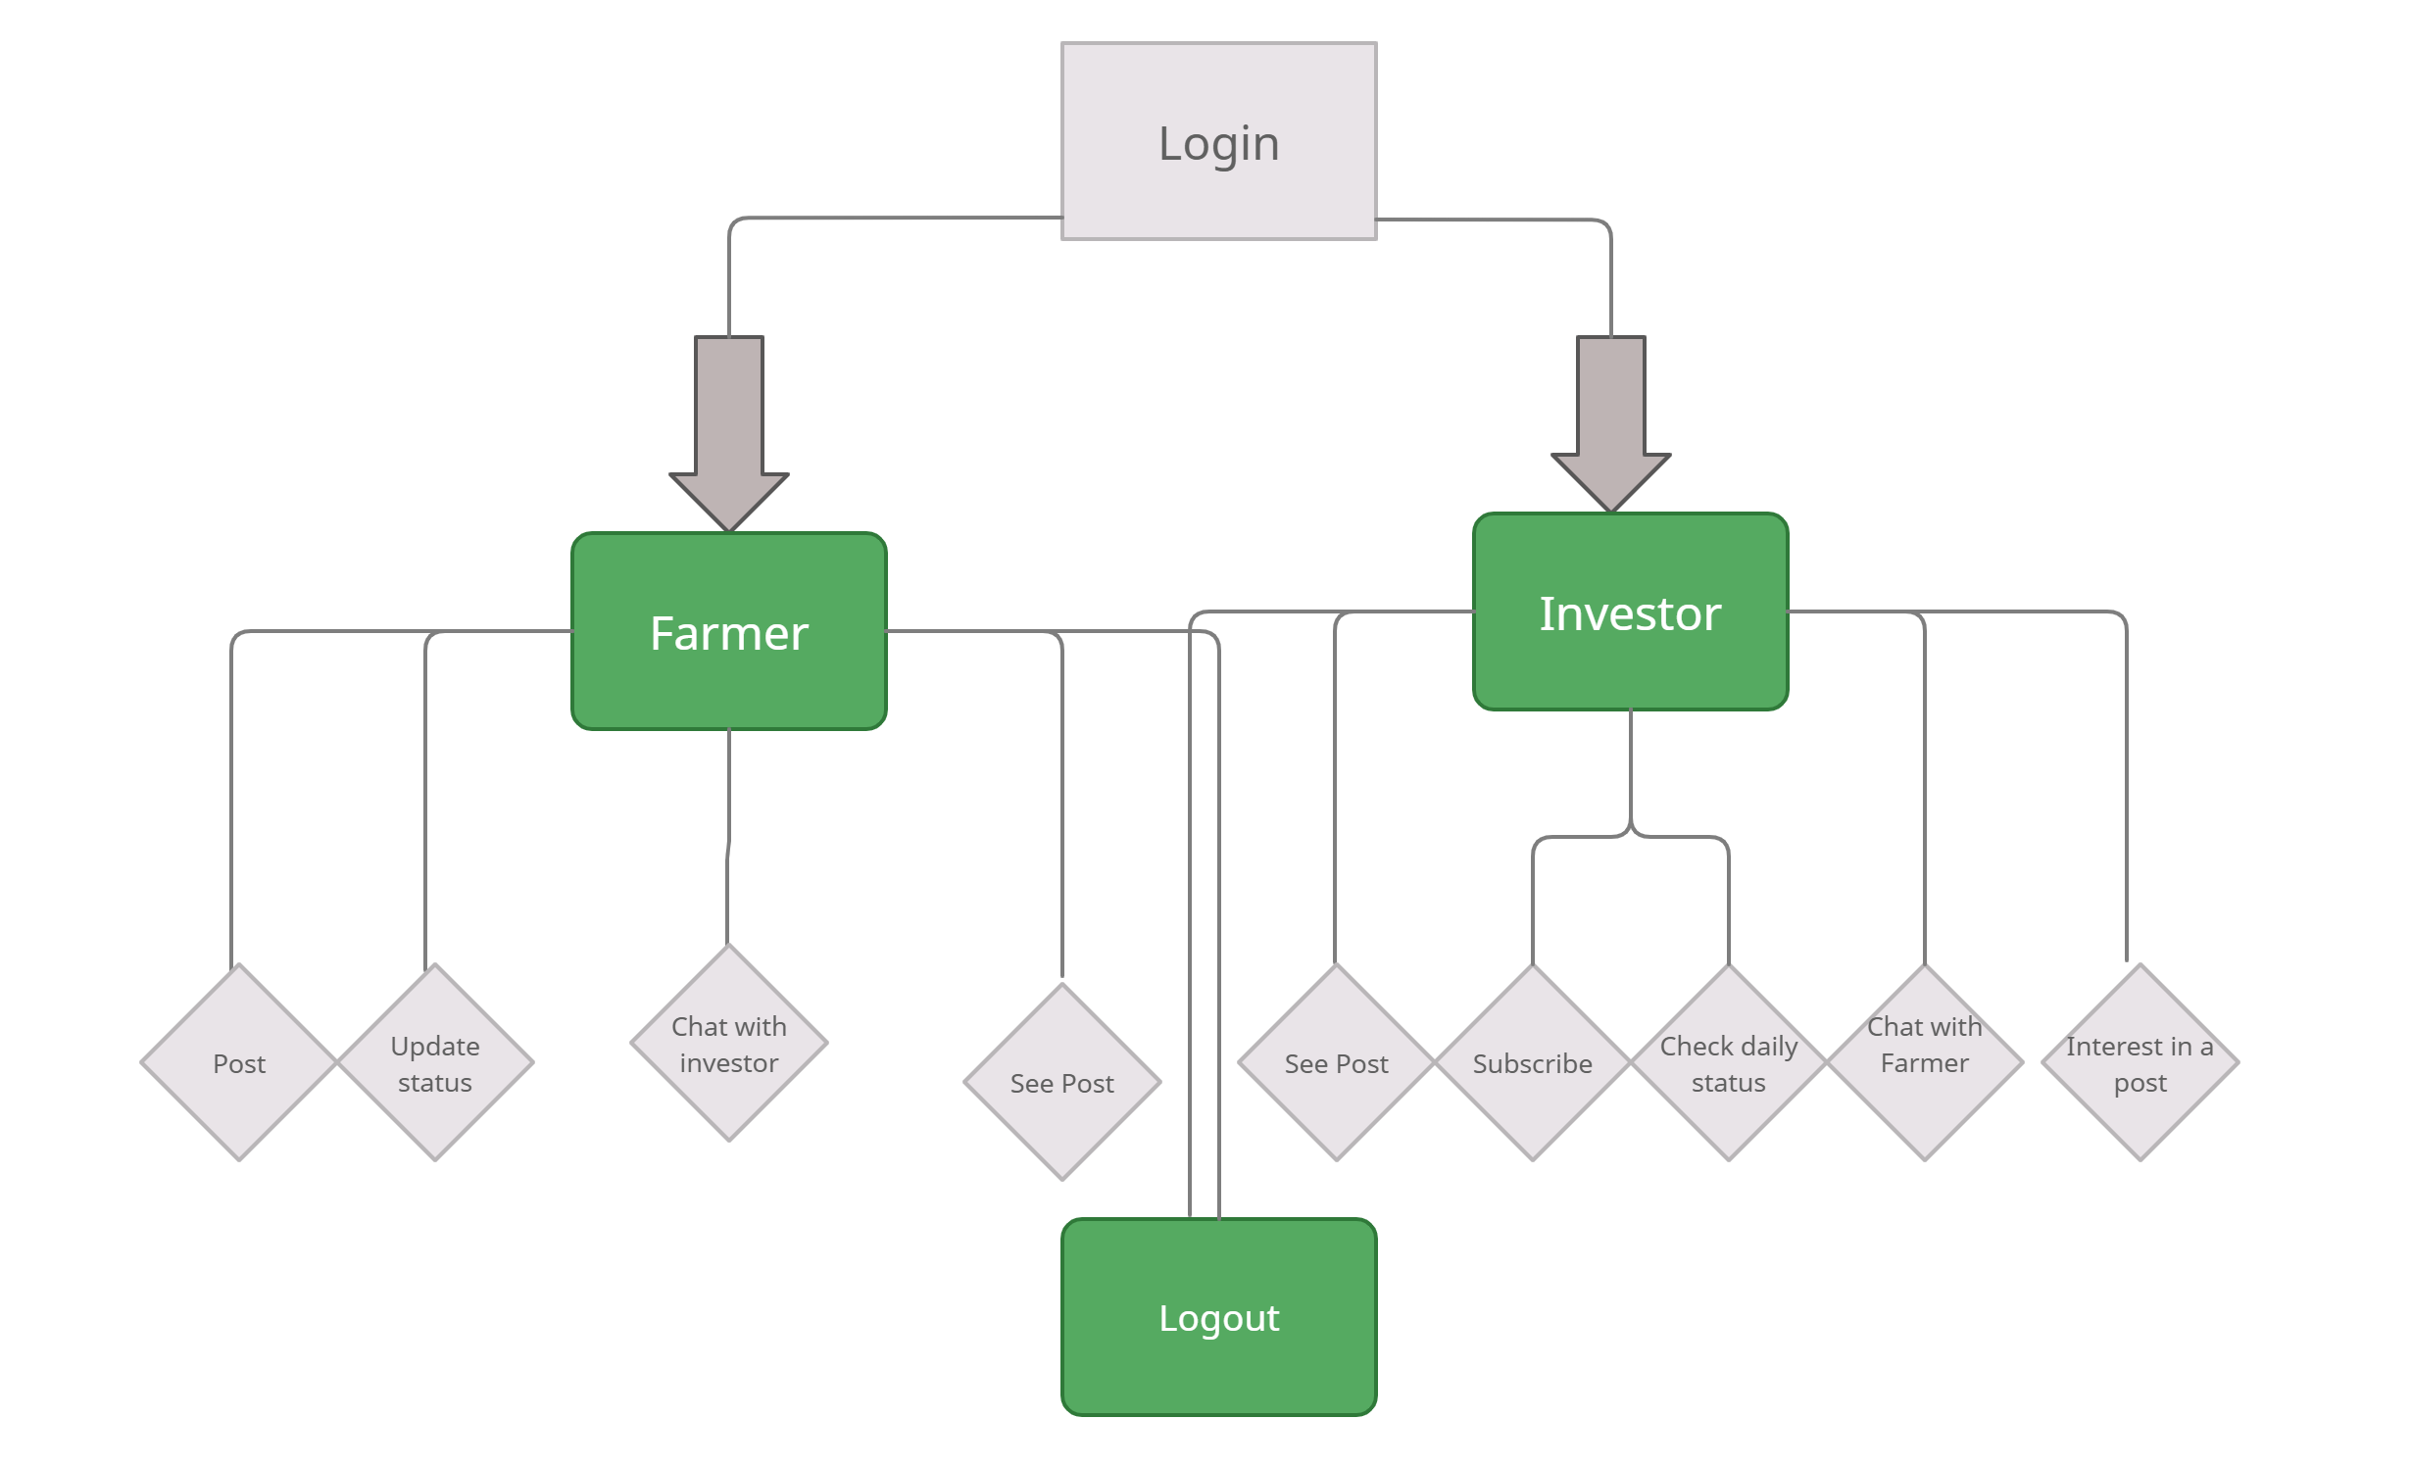
Flow chart

Slide 7
Technology
HTML
PHP
CSS
MYSQL

Slide 8
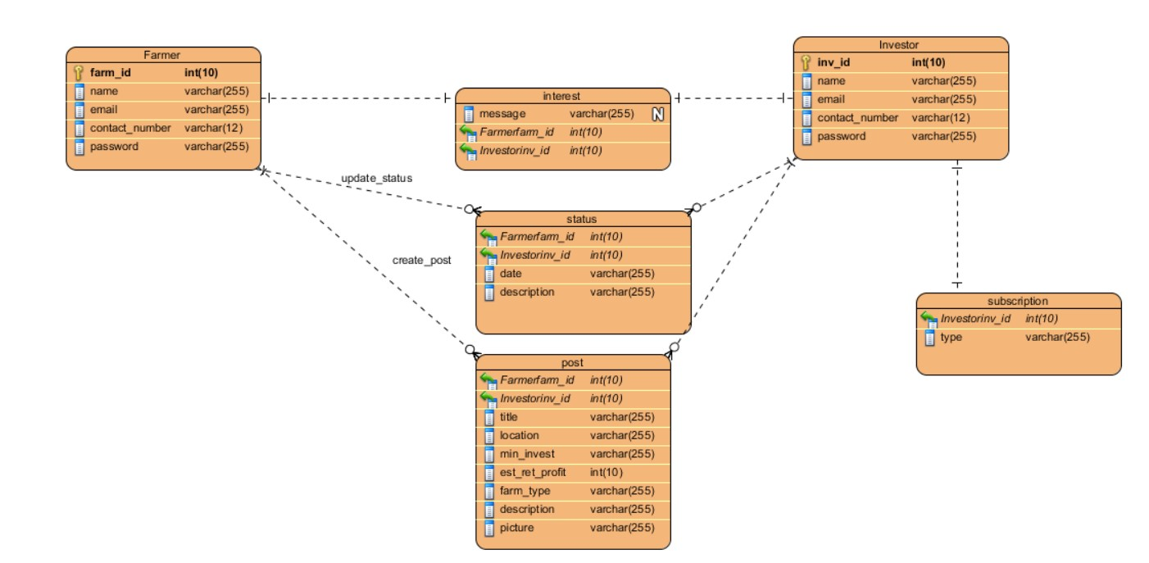
ERD Diagram

Slide 9
Future improvements and plan
Buy Products
Appointing Agents

Slide 10


